Slide 1
Senior Project
Jack Coleman

Slide 2
A programming language for teaching how to program

Slide 3




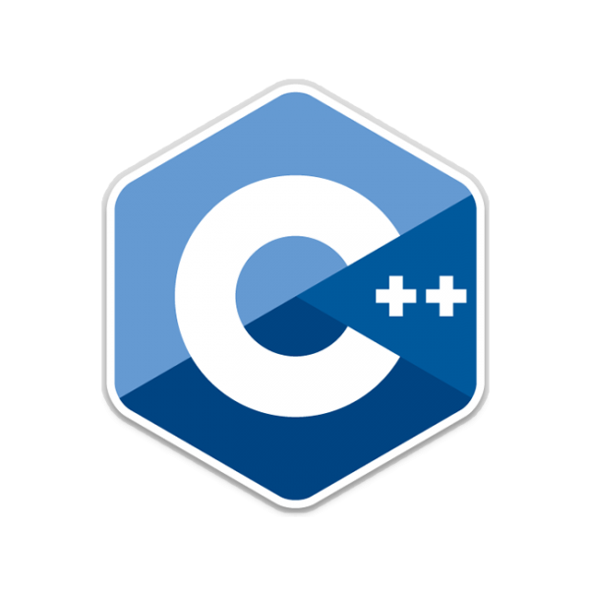
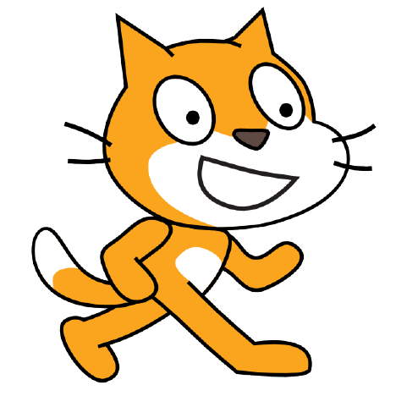


Slide 4
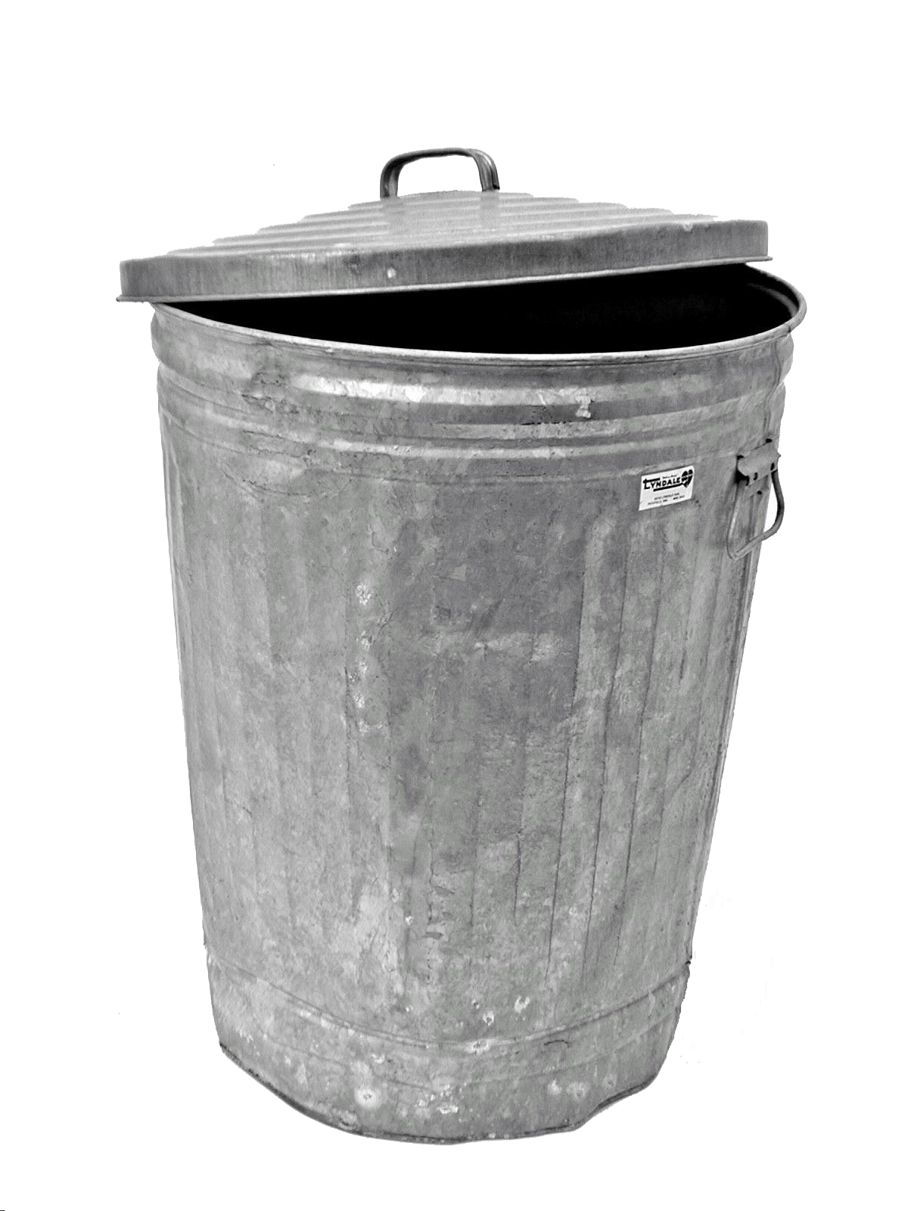

Slide 5
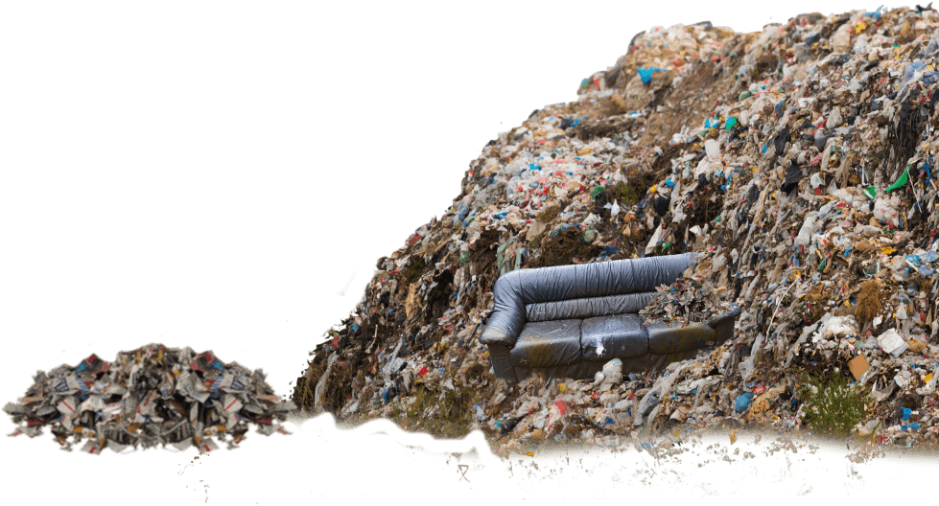

Slide 6

What would this language need to be?
Type oriented
Structural type system
Support dependent types
Support for other paradigms*
Easy to read syntax
Garbage Collected
Easy to reason about
Simple
Homoiconic

Slide 7
An A.I. that creates music

Slide 8

How will it work?
A.I. with general rules about music theory.
Uses previously written notes to travel down a decision tree to determine what the optimal next step in creating its music should be.
If the song the A.I. created was liked by the user it shall give the user the sheet music.

Slide 9
Teaching Computer Science through the cunning use of puppets

Slide 10
Why Puppets?

Slide 11
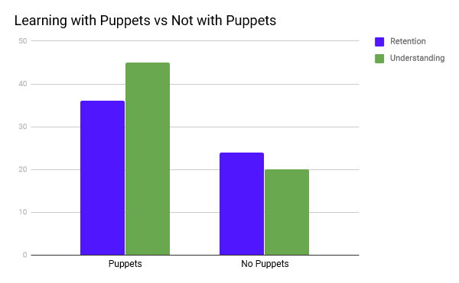
Why Puppets?

Slide 12
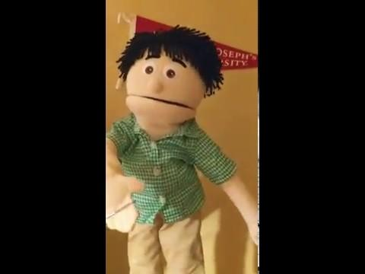
An Example

Slide 13
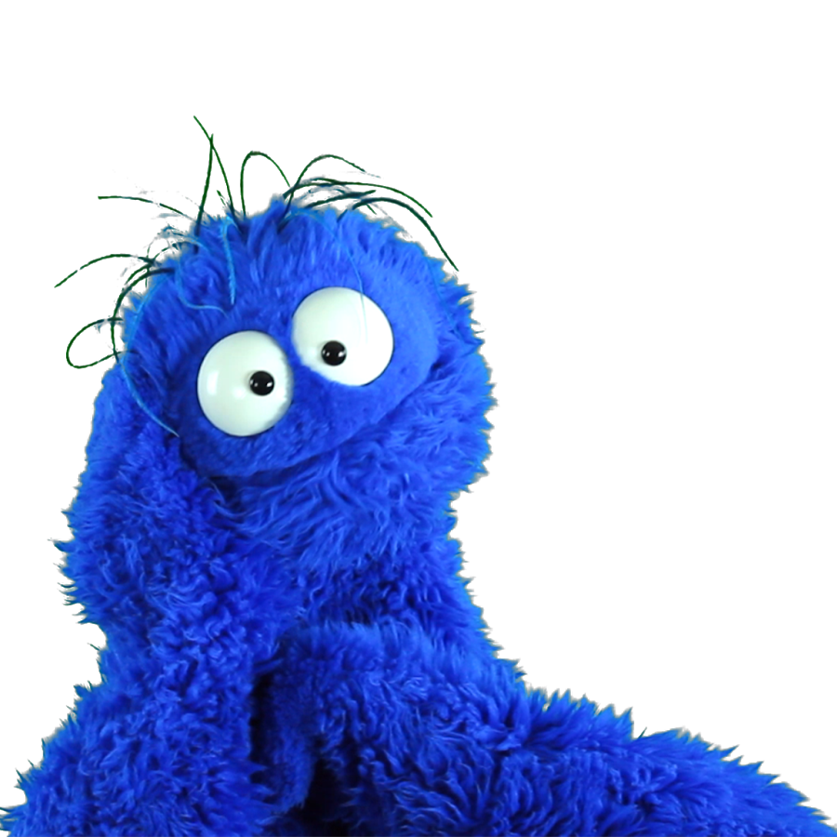
Why I think this is a good idea
Puppets are not intimidating.
Language-Agnostic classes help with general concepts without getting muddled in the syntactic details
Our field will kept growing larger and a easy to understand resource of general concepts is essential for the growth of the next generation of programmers

